Slide 1
QGIS
A free and powerful alternative to ArcMap

Slide 2
Quantum Geographical Information Systems (QGIS)
Can be used for any common GIS task
Reading shapefiles and rasters.
Reading csv tabular data.
Making maps.
Georeferencing images.
More complex GIS tasks
Interpolation.
Projecting data.
Geoprocessing.
Ex (Calculating the area of a shapefile)

Slide 3
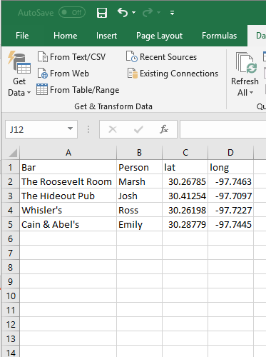
Examples
Csv with point data

Slide 4
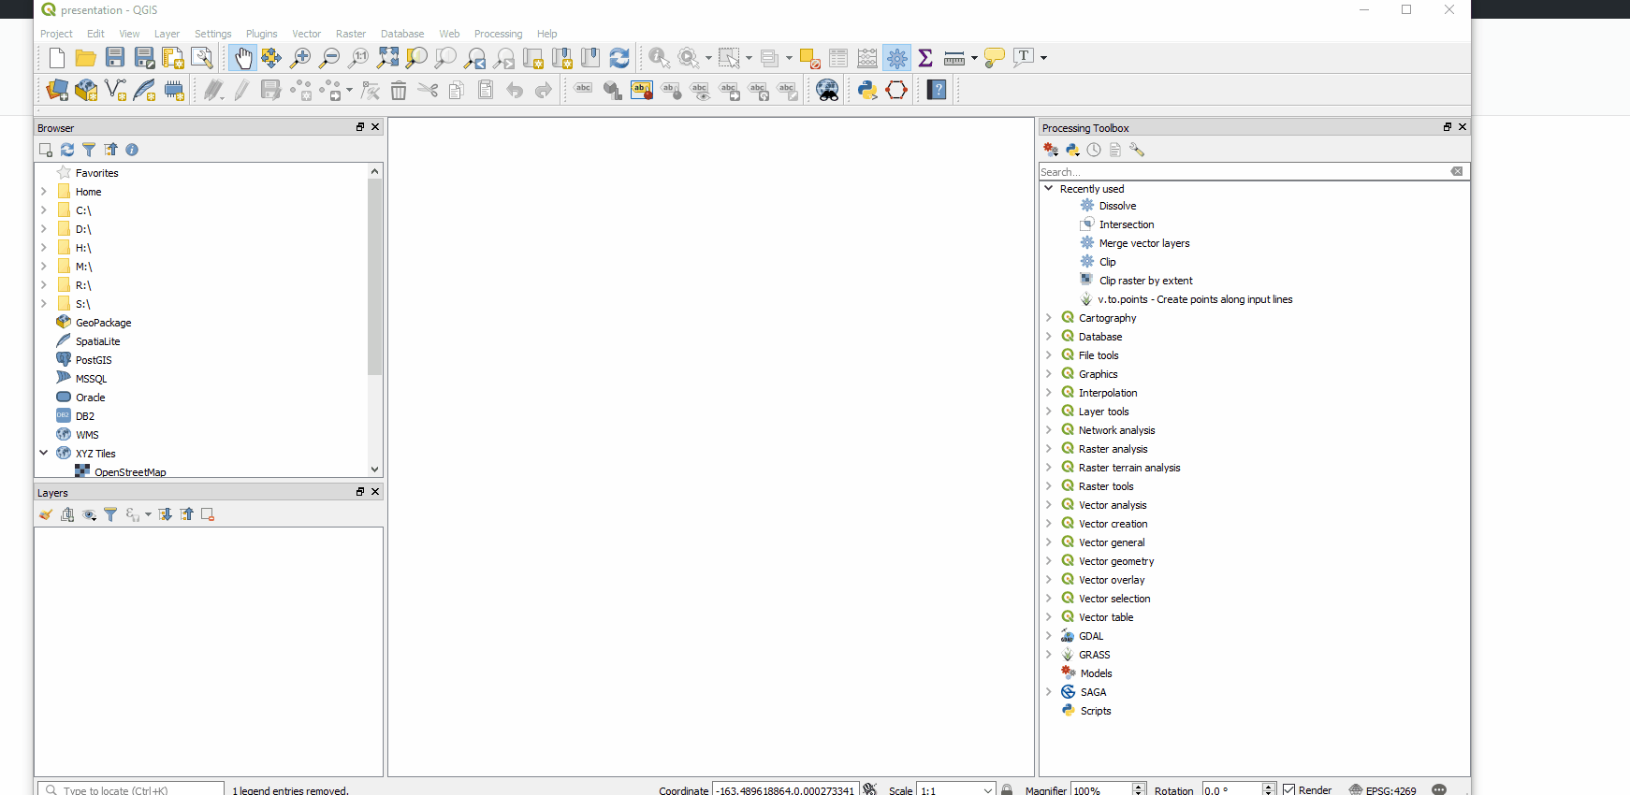
Add csv or delaminated text files

Slide 5
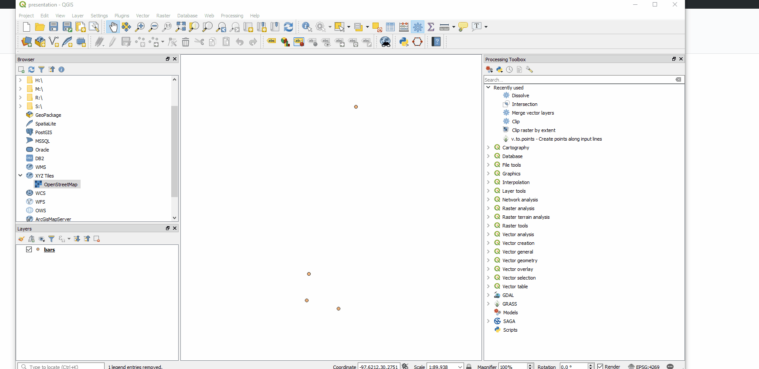
Add a Basemap

Slide 6
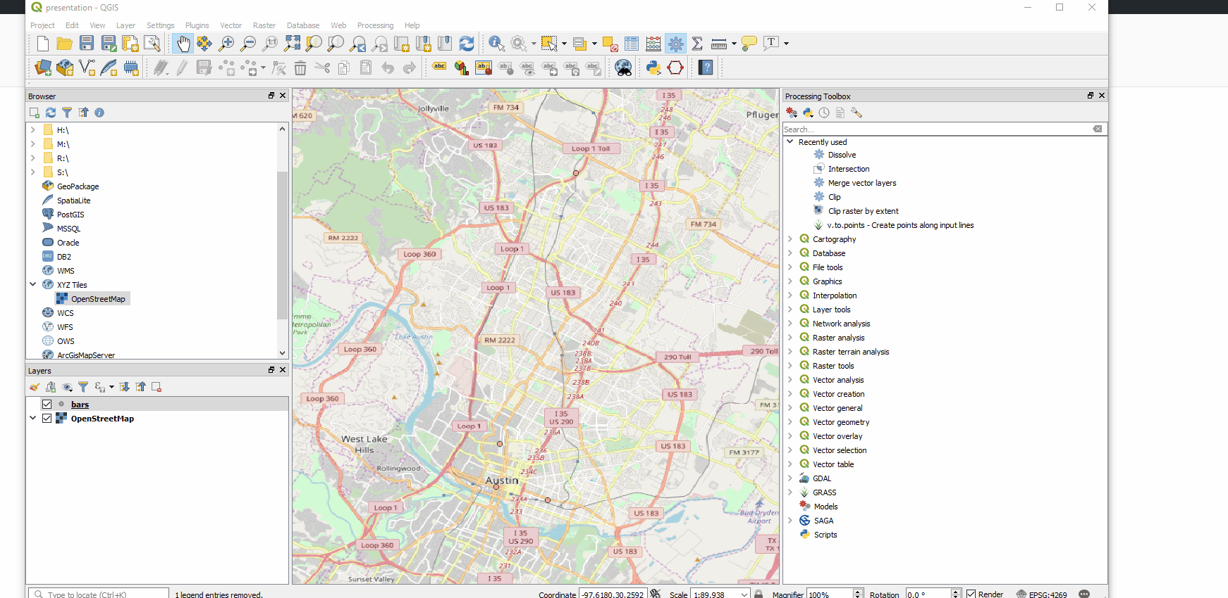
Add Labels

Slide 7
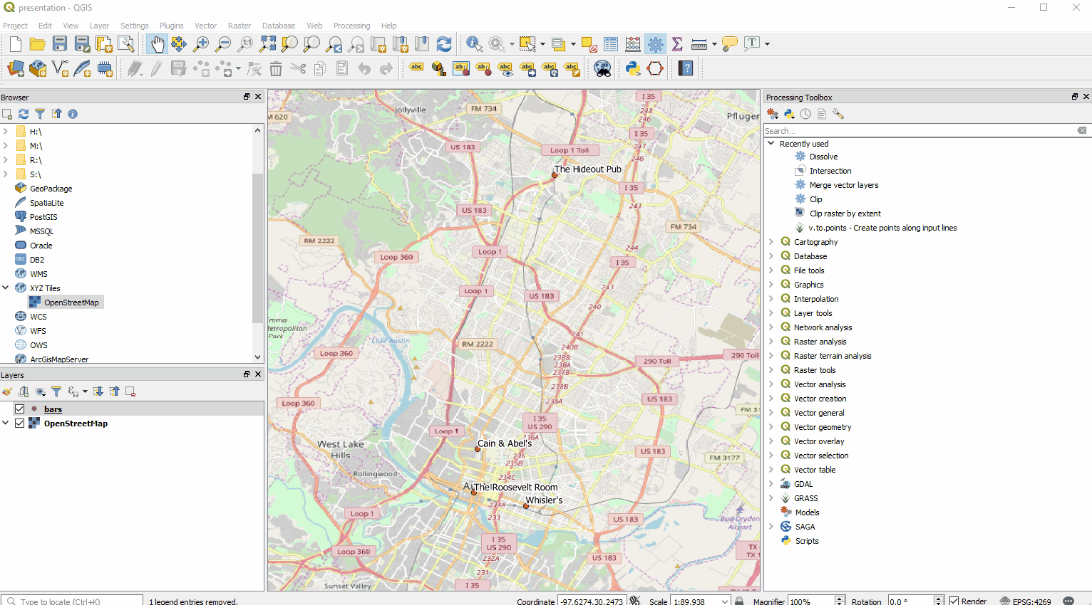
Add Map Layout

Slide 8
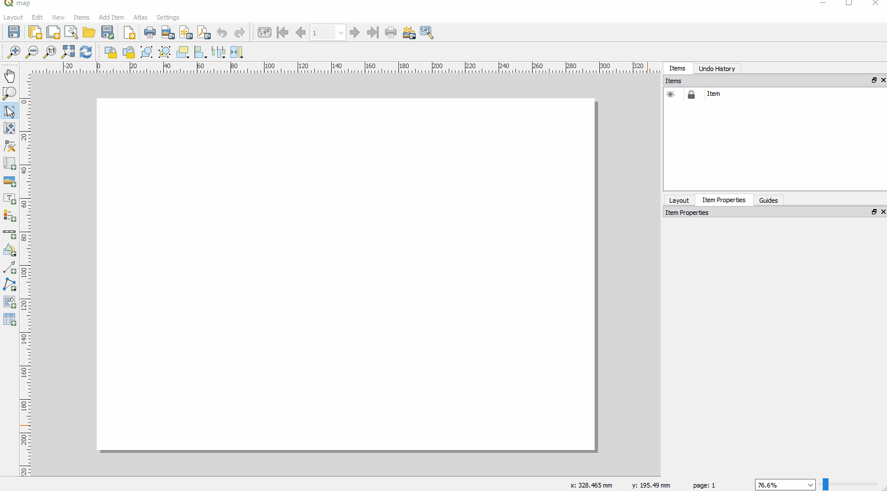
Add Scale Bar and Legend

Slide 9
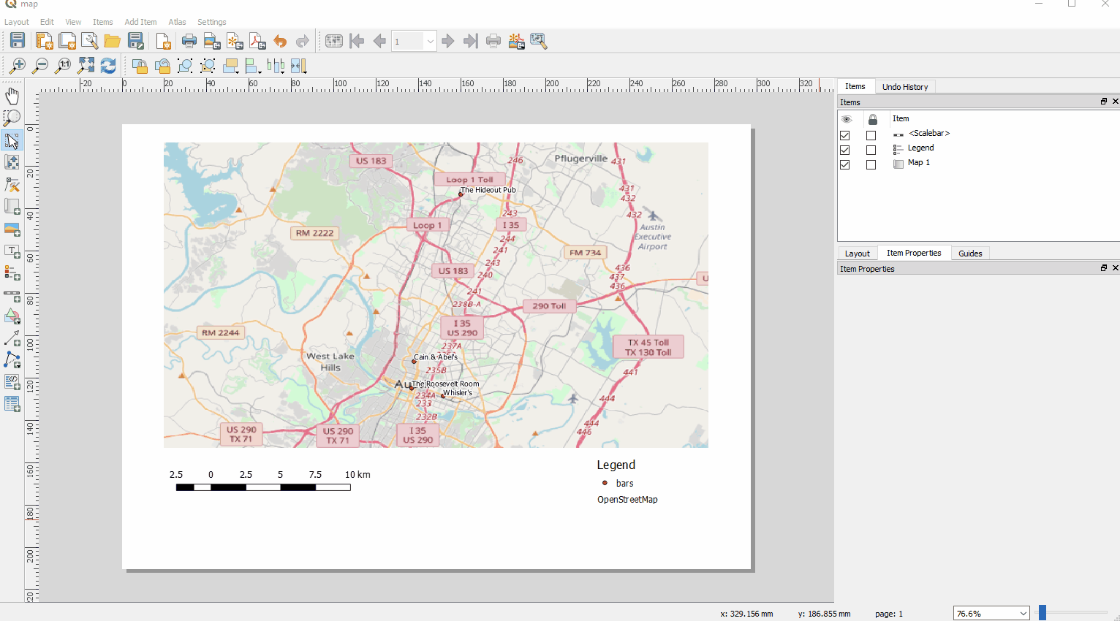
Adjust Legend

Slide 10
From here we can export to a pdf or png

Slide 11
Map layout
Add legend(s)
Add scalebar
Add title and text
Export map to image or pdf

